Slide 1
Architecture of
Network Devices
Masoud Sabaei
Associate professor
Department of Computer Engineering,
Amirkabir University of Technology

Slide 2
Objectives
This course provides an introduction to fundamental concepts in the design and implementation of high performance switches and routers. In this course, students are familiar with IP router architecture, the design goals and the design issues. Each routers have two plane: data-path plane and control plane. The students also will be familiar with the functions of the main two parts of the data path plane which are line cards and switch fabric.

Slide 3
Contents
Introduction, High Performance IP Router Architecture, Design Goals and Design Issues
IP Address Lookup
Packet Classification
Traffic Management
Packet Switching Fundamentals
Shared Memory Switches
Input Buffer Switches
Banyan-Based Switches
Software Defined Networking

Slide 4
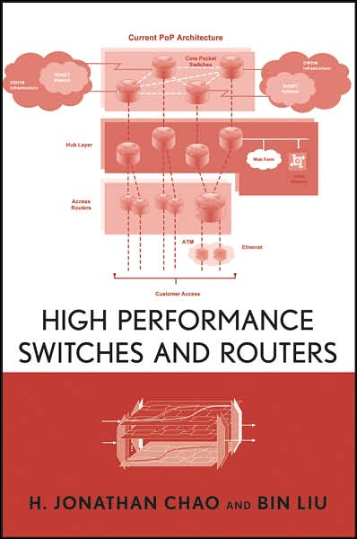
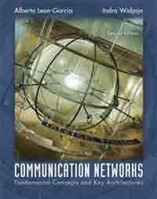
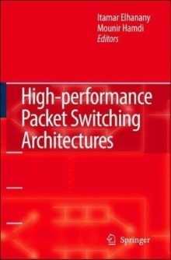
References
High Performance Switches and Routers
H. Jonathan Chao, and Bin Liu
2007, Wiley
Communication Networks, 2/e
Alberto Leon-Garcia, Indra Widjaja
2003, McGraw-Hill
High Performance Packet Switching Architectures
Itamar Elhanany, Mounir Hamdi
2007, Springer
& Related Conference and Journal Papers

Slide 5
Evaluation
Final Exam d-Term 60%
Homework and Assignments 40%

